Slide 1

Sentiment Analysis of Tweets Project
Jess Ho

Slide 2
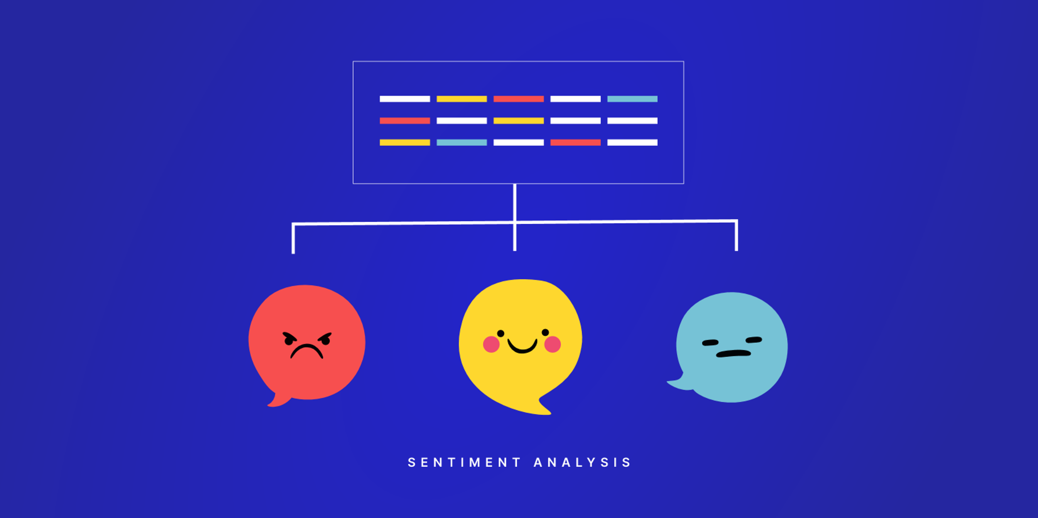
Sentimental Analysis
Sentimental Analysis: A Natural Language Processing technique that aims to determine a text's overall emotion.
Natural Language Processing (NLP): Technology that helps computers understand human language.
Nowadays lots of text data, such as reviews, emails, tweets
Notes:
NLP can be used for tasks like spell check and sentiment detection

Slide 3

Project Introduction
Solving the problem of automatically classifying recorded tweets from Twitter into sentimental categories using machine learning.
Aim : Train a dataset in 3 different machine learning algorithm models and test to see which is most accurate
Software used : MATLAB
Classification Algorithms used: K-Nearest Neighbour, Decision Tree, Discriminant Analysis
4 Sentiment Categories:
Tweets
Relief
Happiness
Surprise
Enthusiasm

Slide 4
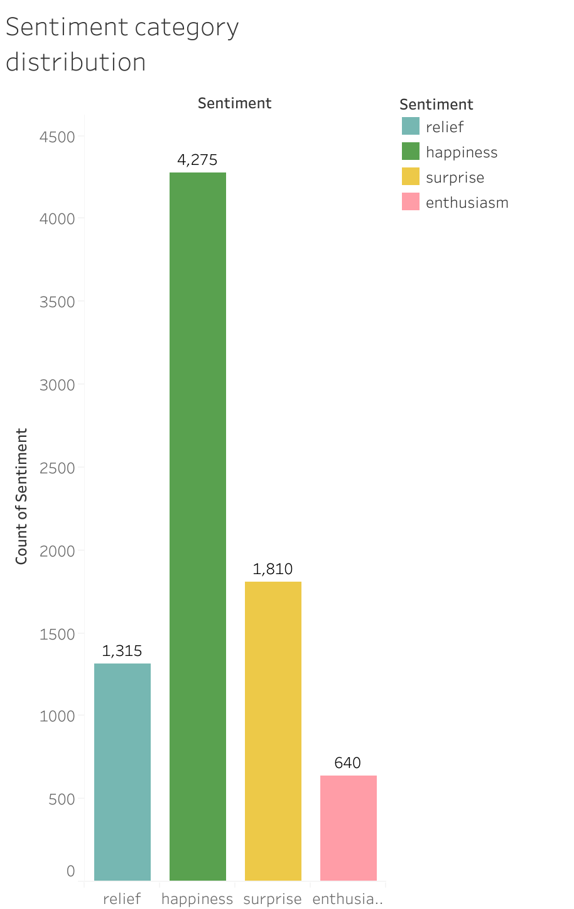
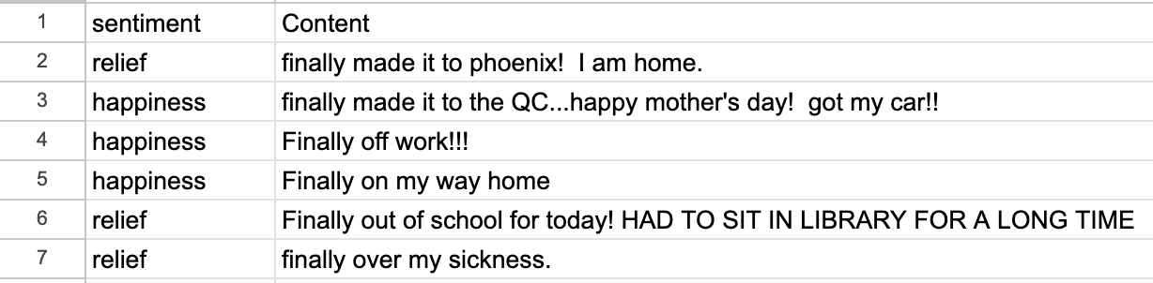

Data and Preparation
CSV file containing two parts:
Tweet Content
Sentiment Label
Imbalance in category distribution
Challenges:
Misspelt words
Noise in Data
Abbreviations / Slang
Mixed Sentiments
Capitalised words

Slide 5

Data and Preparation
Splitting data into:
Training Section: Used to train algorithm models.
Testing Section: Used to evaluate model performance.
Testing features used to make predictions, compared against their labels.
Collection of Tweets
Term Frequency-Inverse Document Frequency Matrix
Train-Test Split
Divide the text into smaller units (words) called tokens
Import the csv file into MATLAB as a table
Training Section : first 6432 rows
Testing Section : rest of the 2219 rows
Remove stop words, punctuation and words with < 100 occurences
Tokenize
Built a Bag of Words
Methods I used to overcome challenges in data?
Removing Stop Words and Punctuation
Reduces dimensionality
Loss of Context
Bag of Words is a simple way to represent text data by focusing on the frequency of the words
Easy to implement and interpret
Can capture overall sentiment
Can capture slang
Ignores word order and context
Excluded words with fewer than 100 occurrences
Convert everything to lower case

Slide 6
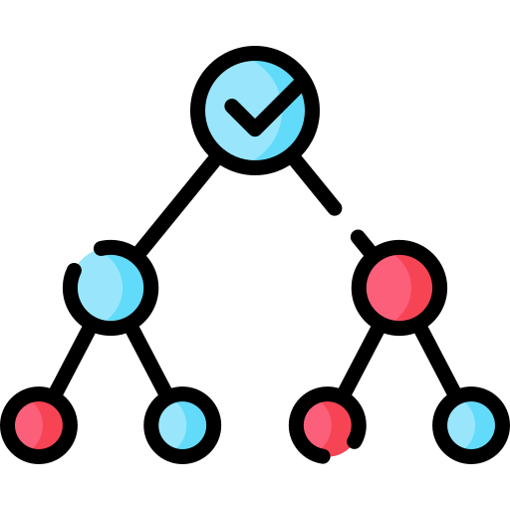
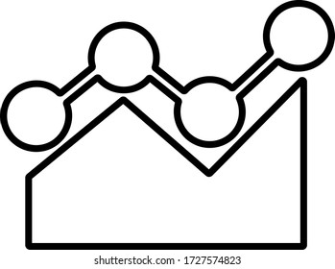

Classification Algorithms
The training data that was made in the preparation steps before is used to train three classification algorithms with the training features and training labels being the parameters used in the functions implemented in MATLAB
SUITABLE FOR NON-LINEAR DATA
The Decision Tree
Uses a hierarchical tree structure to split data based on parameters.
Splitting continues until reaching a leaf node representing a class label.
Discriminant Analysis
Estimates probabilities for each class and selects the class with the highest probability
K-Nearest Neighbour (KNN)
Classifies based on proximity, selecting K closest points to the test data.
Chooses the majority class among those points.
FAST PREDICTION SPEED
EASY INTERPRETABILITY
MEDIUM PREDICTION SPEED
NO ASSUMPTIONS ABOUT THE DATA
COMPARE WITH FASTER MODELS

Slide 7
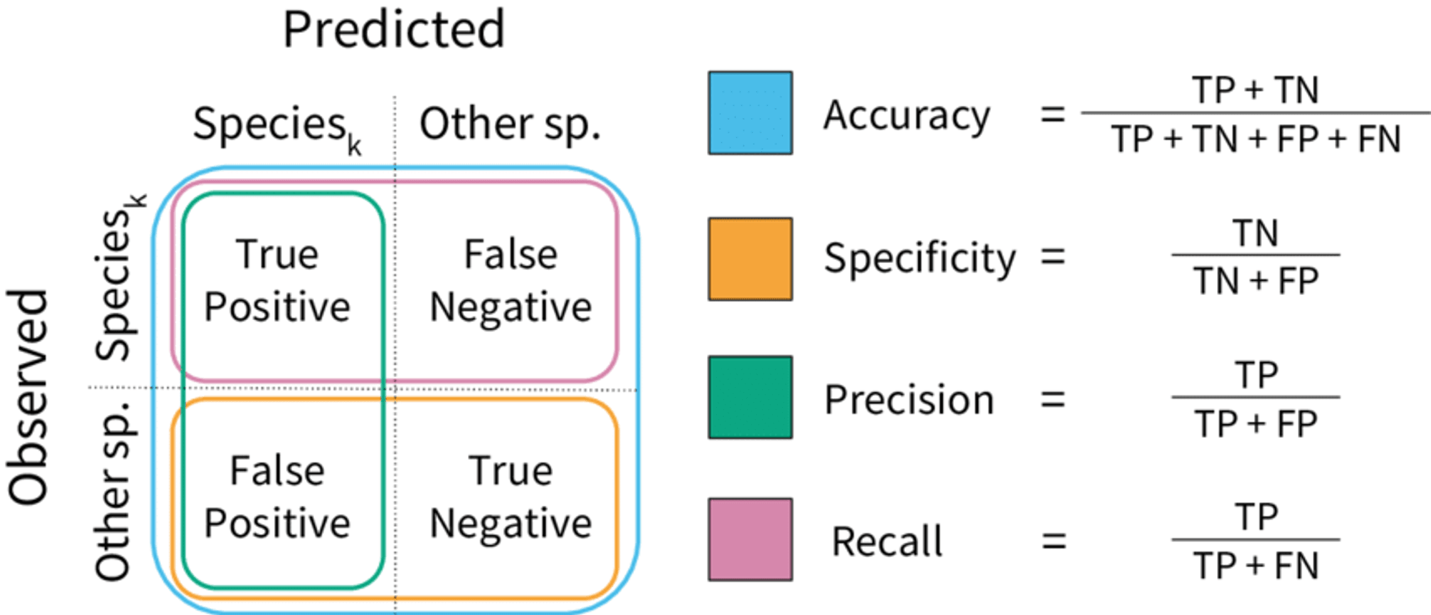

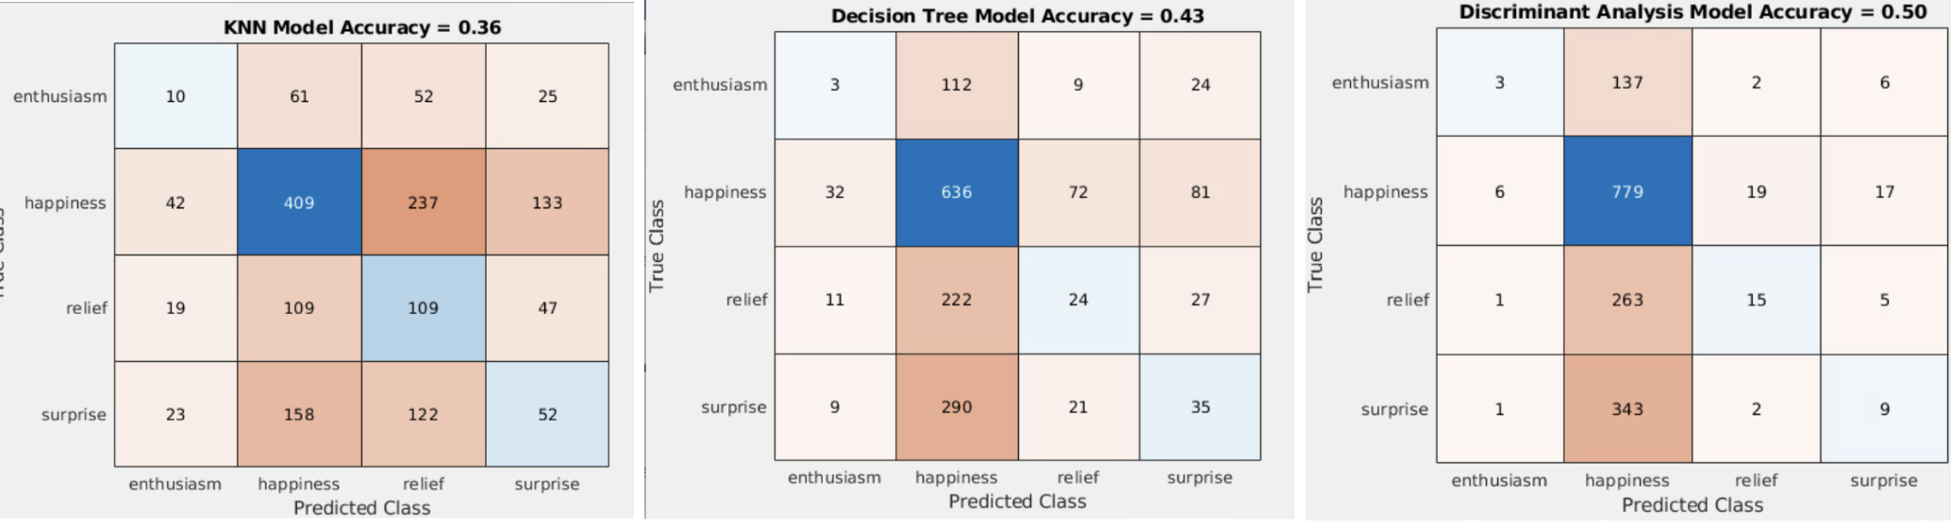
Results:
Confusion Matrices
Most precise model for predicting:
Enthusiasm = Discriminant Analysis
Happiness = KNN
Relief = Decision Tree
Surprise = Discriminant Analysis
Discriminant Analysis 50% accuracy
Decision Tree 43% accuracy
KNN 36% accuracy

Slide 8
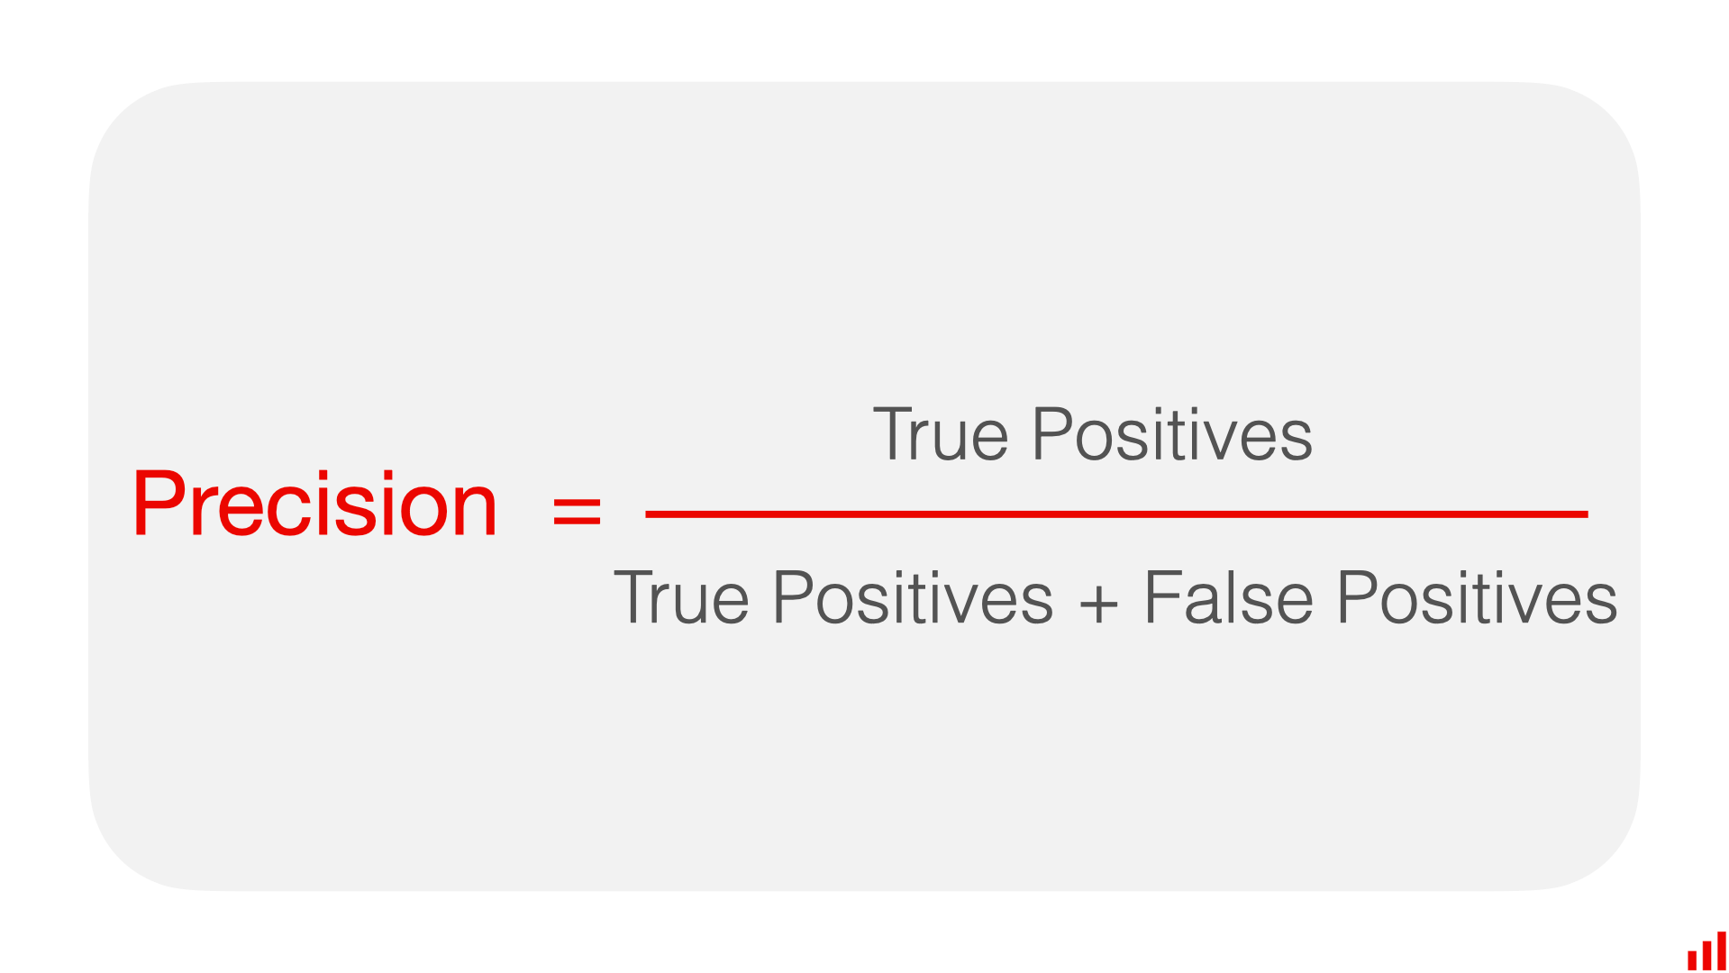
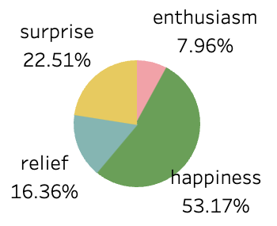
Model Performance Comparison
Accuracy calculated as the proportion of correctly predicted labels out of total testing labels.
 | K-Nearest Neighbours | Discriminant Analysis | Decision Tree
Precision of Enthusiasm | 11% | 27% | 5%
Precision of Happiness | 55% | 51% | 50%
Precision of Relief | 21% | 39% | 57%
Precision of Surprise | 20% | 24% | 21%
Overall Accuracy | 36% | 50% | 43%
Happiness precisions are similar:
This could be because happiness category bigger so models are more accurate?

Slide 9
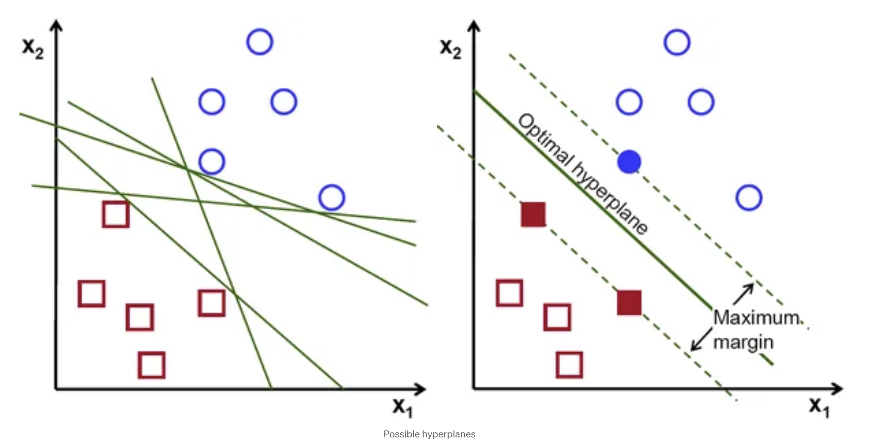
Conclusion and Recommendations
Recommended Model to solve problem of automatically classifying recorded tweets from Twitter into sentimental categories:
Discriminant Analysis
Limitations with this project:
Overall it has the highest accuracy as well as the best prediction precision for 2/4 sentimental categories
Very simple and fast
Analysis is quite sensitive to outliers and the size of the smallest group must be larger than the number of predictor variables
50% accuracy isn’t very high
No negative sentiments
Imbalance in category distribution
Techniques I could’ve explored:
Using negative emotional categories
Use more varied data / category distribution
Include punctuation: treat as features
E.g. (!) often used for excitement or emphasis “Amazing!”
Sentiment Scoring for punctuation with rule based weights
Have a team of human annotators label data on well defined sentiment criteria / a guideline / multilabel classification with both positive and negative labels
E.g. “movie was visually stunning but story was boring”
Other Considerations:
Explore models such as the Support Vector Machine (SVM) which is a popular model since it uses little computation power but still produces significant accuracy.

Slide 10

Why is Sentimental Analysis
of Tweets important?
Increase in technology / social media
Monitoring Brand Reputation
Find Trending Twitter Hashtags
More and more people accustomed to expressing their honest opinions online on social media platforms like Twitter
Customer feedback and opinions are important to businesses to make improvements
Quickly and easily monitor brand's reputation
Help predict business niche trends
Discover opinions about competition
E.g. looking at reviews on TfL service
Notes:
Useful in helping Businesses gather feedback
: Understand customers better

